Slide 1

Chetan Sharan
Data Scientist|Engineer|Private Pilot
IIT Kanpur

Slide 2
Problem Statement
Develop a state-of-the-art question-answering model leveraging the Quora Question Answer Dataset. The objective is to create an AI system capable of understanding and generating accurate responses to a variety of user queries, mimicking a human-like interaction.

Slide 3
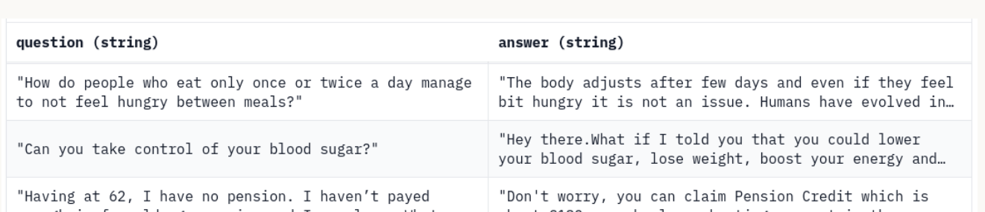
Understanding Data & Literature Review

Slide 4
The Game Plan
Preparing Data
Model Selection
Setting Up the Environment
Fine-Tuning the Model
Evaluation and Testing

Slide 5
Chapter One
Cleaning
Tokenization
Stop Word Removal
Stemming/Lemmatization

Slide 6
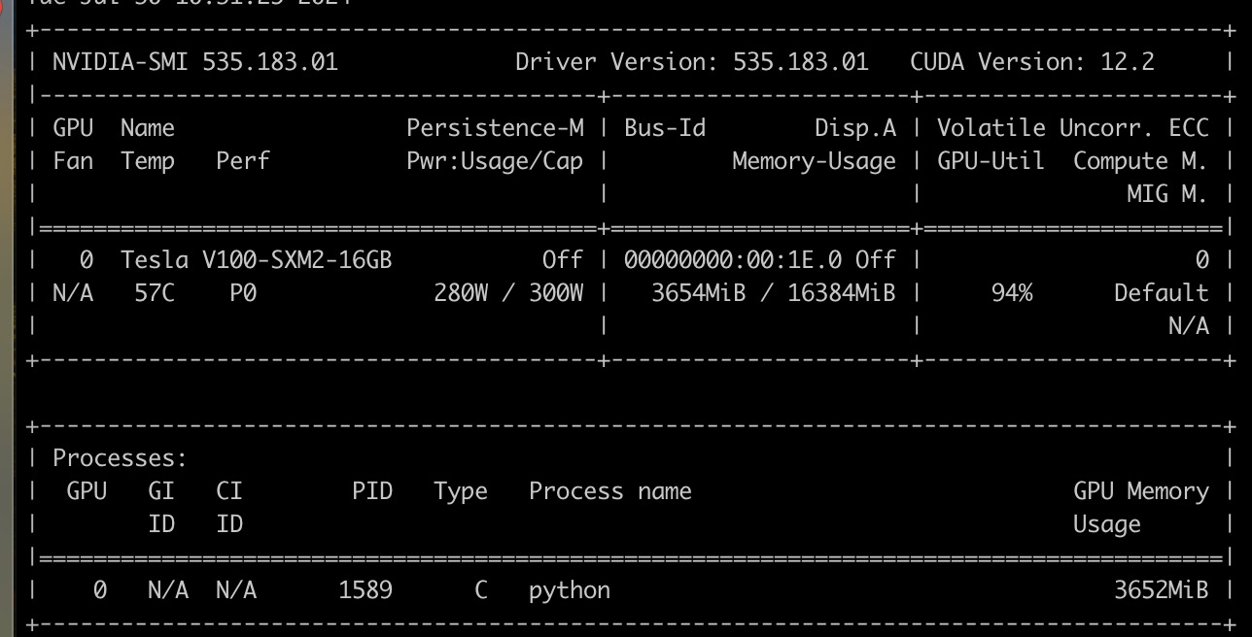
Lets talk about money

